Slide 1

Creativity And Innovation
Presented By:-
Muskan Garg
Ananya Agrawal
Kirtikaa Sharma
Ritika Singh
Guided By:-
Dr. Nirbhay Mishra

Slide 2


Slide 3
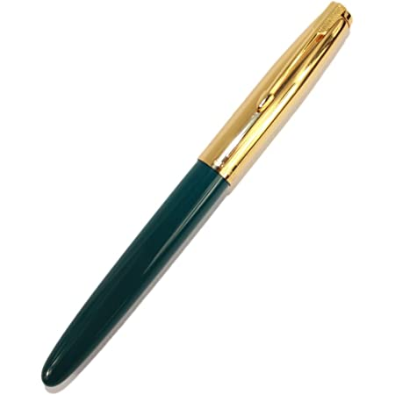

10 uses of Pen

Slide 4
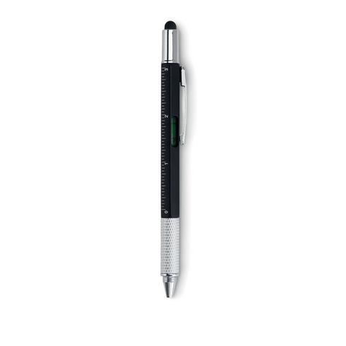
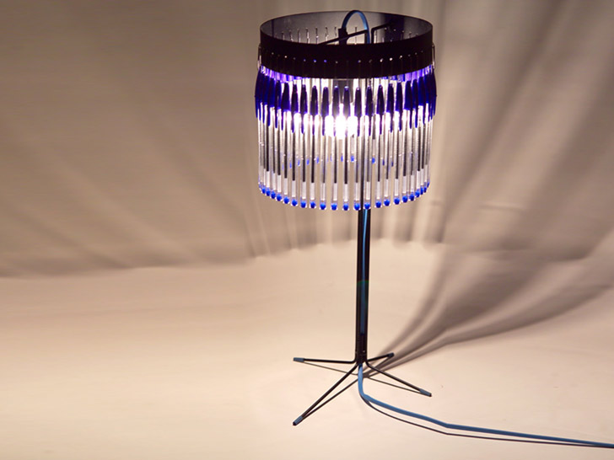
for writing
as a straw
as a toy "telescope" for kids
to unlock a bike lock
to make a crossbow
for an improvised tracheotomy (on TV, anyway)
as a paper punch
to store & pass secret messages (pop out the tube of ink, insert a small paper scroll, put ink back)
to make a chandelier
use the sharper end of the pen top to scrape away excess glue
as an improvised stabbing weapon
to shuttle back and forth messages: run a long string through the tube,
tape a message to the tube, send on its way
as a source of plastic to melt down
as a wire guide
use the ink to ruin a perfectly good white shirt
use the pen top to enhance your key chain flashlight
create a blow gun / spitball delivery device
use as a ruler
remove the guts and use to carry toothpicks or other small objects
as a building material kids projects (think Lincoln Logs, but using pen

Slide 5

INNOVATION:
Innovation can be broadly thought of as new ideas, new ways of looking at things, new methods or products that have value.
Innovation contains the idea of output, of actually producing or doing something differently, making something happen or implementing something new.
CREATIVITY:
Creativity is an active process necessarily involved in innovation.
It is a learning habit that requires skill as well as specific understanding of the contexts in which creativity is being applied.
Switch from Scooters to Bikes:-
The invention of the motorcycle make us realize that we can also ride bikes without making any extra efforts like kicks as it starts automatically by clicking the switch.
Creativity
Thought of creating a new auto-start bike
Innovation
Actual invention of bike

Slide 6
Creativity, Innovation and Learning
Learning involves challenging, refining and improving understanding by being made to think hard.
Approaches of thinking should be:
Creative and imaginative
Lateral (incorporating new ways of looking at things),
Linear (using existing patterns of thought)
Characteristics of a powerful creative process are:
Understanding of the domain being investigated
Willingness to question
not be constrained by existing knowledge.
“Creativity represents a balance between knowledge and freeing oneself of that knowledge” (Johnson-Laird, 1988, p.207, cited by Sternberg, 2012, p.4).
Creative Process Needs:
complement diligent and deliberate practice
To develop foundational skills

Slide 7
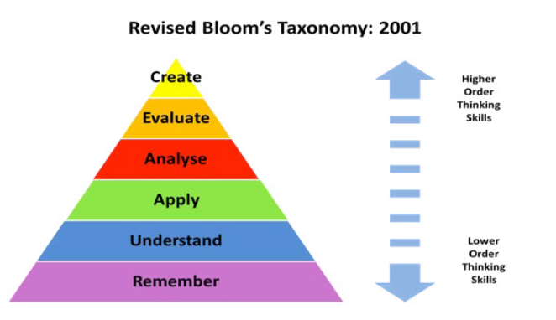
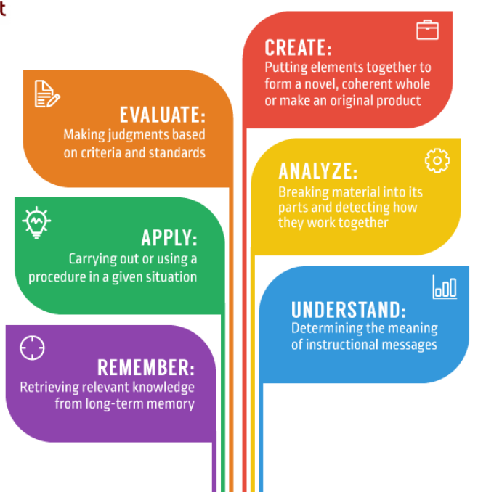
Revised Bloom’s Taxonomy : 2001
A revised version of Bloom’s original 1956 taxonomy by Krathwohl (2002, p.212–218) includes creativity in the taxonomy and places creativity above evaluation as a higher-order thinking skill.

Slide 8

Example-1

Slide 9
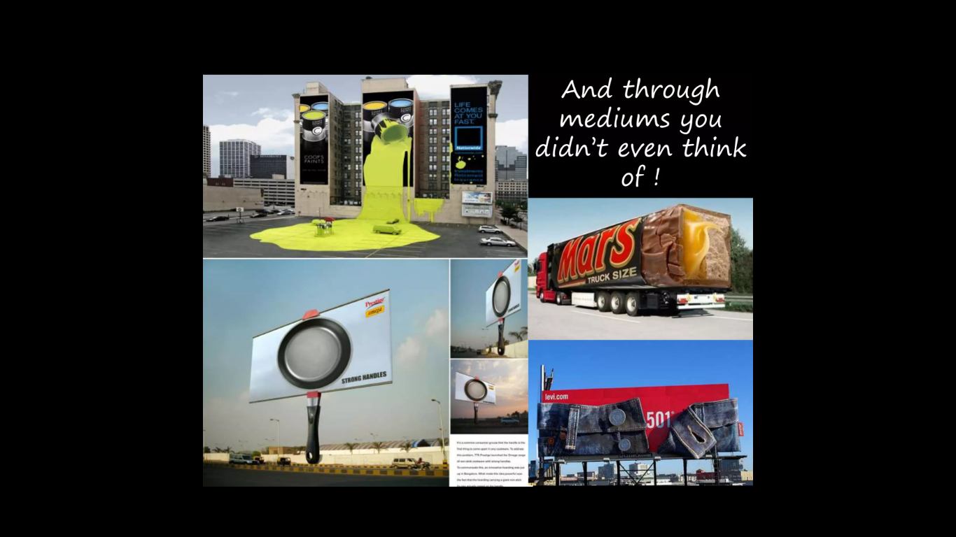
Example-2

Slide 10
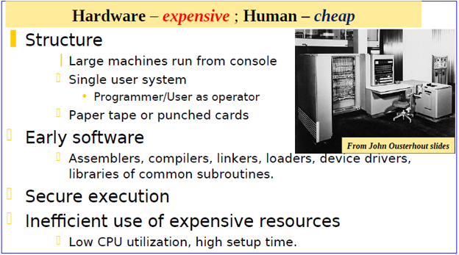
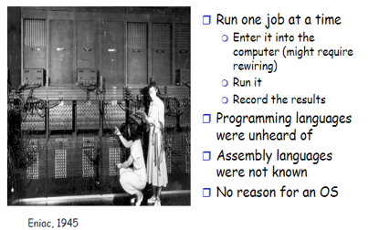
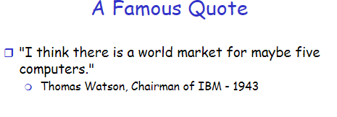
First Generation: Direct Input (BARE MACHINE) 1945-55
Mechanical Parts, Vacuum Tubes and Plug Boards

Slide 11
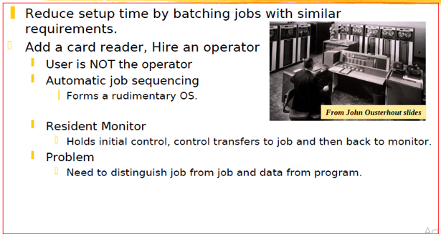
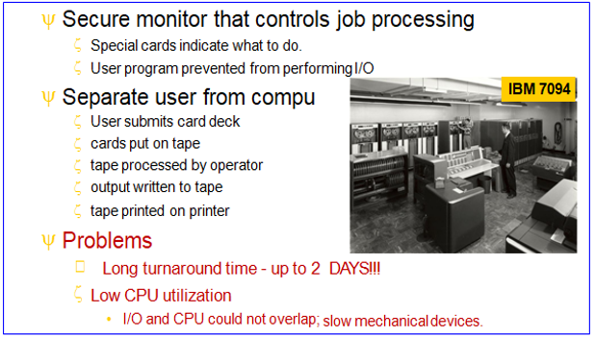
Second Generation: Simple BATCH System
Transistors were used instead of vacuum tubes.
These are also called single-stream batch processing system. These computers were called mainframes used in large rooms by professional engineers & could perform a single task at a time

Slide 12
For the overall and proximal development of the student, cultural sensitivity is particularly important. The students need to be guided if they are not used to demonstrating their creative habits. How the creative activity leads to broader learning objectives needs to be well understood by the teacher as well as by the student.
Having a creative habit, the disposition to behave creatively is critical. One should have a playful attitude while remaining disciplined.
Whenever possible. Play should always be used to extend the wide range of opportunities to think.
There are several character traits and learning habits that affect a learner’s personal disposition , motivation and confidence to be creative. For ex-
Resilience: ana ability to tolerate uncertainty and preserve at a task to overcome obstacles.
Not being afraid to make and learn from mistakes.
An ability to suspend judgement while generating ideas.

Slide 13
willingness to take sensible risks or go out of their comfort zone in their work.
A creative learner needs to be able to develop and apply a set of skills that they can use in the creative process. These include being able to:
clarify, analyze and re-define the problem or question to uncover new ways of looking at it
ask thoughtful questions
notice connections between seemingly unrelated subject matter
challenge established wisdom by asking: how would I improve this?
recognize alternative possibilities
look at things from different perspectives.
Creative processes usually require self-regulation and the ideas relating to reflection and metacognition considered in Chapter 3 apply. These include learners:
being aware of their own skills, both strengths and limitations
thinking of a range of different strategies or approaches to use in response to a problem or question

Slide 14
planning which approach to use
monitoring their work, and being flexible enough to change to a different approach if necessary
critically evaluating their work at appropriate points

Slide 15


